Slide 1



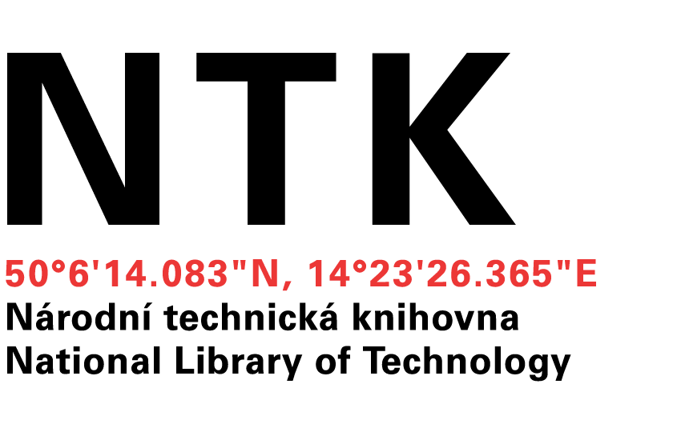
Building cross-field national data repository
Miroslav Šimek
Lukáš Koštenský
Notes:
Míra

Slide 2
Building cross-field national data repository
Scientists at universities need to store and access their data
Smaller teams have no technical background (people, hardware, software) to build the solution themselves
We were asked by several teams from various scientific fields if we can provide a solution
Photo: maps.google.com
Notes:
The aim of the project is to create a proof of concept solution that could serve as a basis for a country-wide data repository

Slide 3
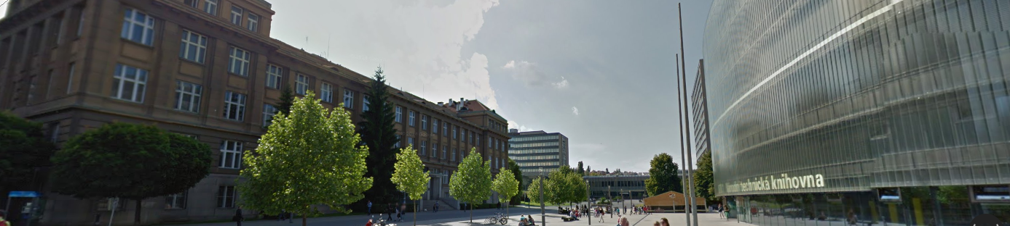
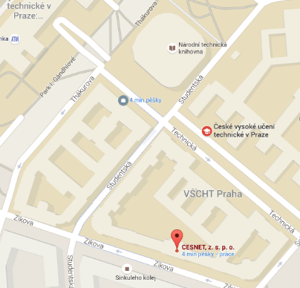
CESNET, NTK, UCT Prague?
CESNET
An association of universities of the Czech Republic and the Czech Academy of Sciences, provides infrastructure
NTK
The largest and the oldest library of science and technology provides metadata expertise
UCT Prague
Pilot implementation
Photo: maps.google.com
Notes:
CESNET
Operates and develops the national e-infrastructure for science, research and education
Provides
Networking infrastructure, Czech academic identity, federation eduID.cz, Data storage (21PB of space), Collaborative environment, Distributed grid computing
Well established and trustworthy academic service provider
In 2013, CIS and NTK joined forces and founded ChemTK, a shared library of chemistry, sharing not only books but also e-sources and people
Department of Organic Chemistry of the Czech Academy of Sciences joined ChemTK in 2015

Slide 4
Cross-field repository
Initial groups of users
Repository for scientific data
Department of Organic Chemistry, UCT Prague
Romany Studies, Faculty of Arts, Charles University
Document repository
UCT Prague
institutional repository (qualification works, articles, other documents)
media repository
Photo: maps.google.com
Notes:
Lukas

Slide 5
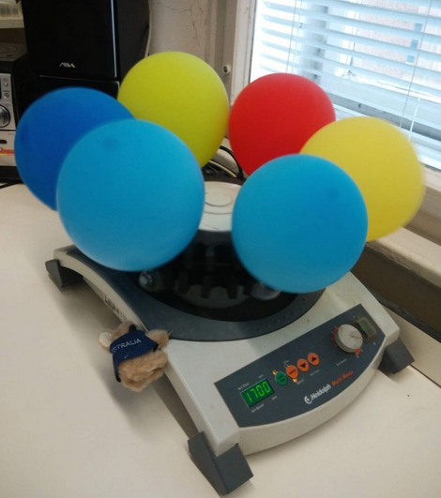

Department of Organic Chemistry
Source: uoch.vscht.cz
Notes:
Mira

Slide 6
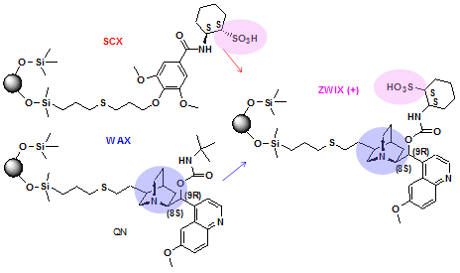
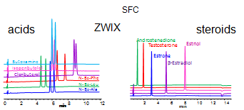
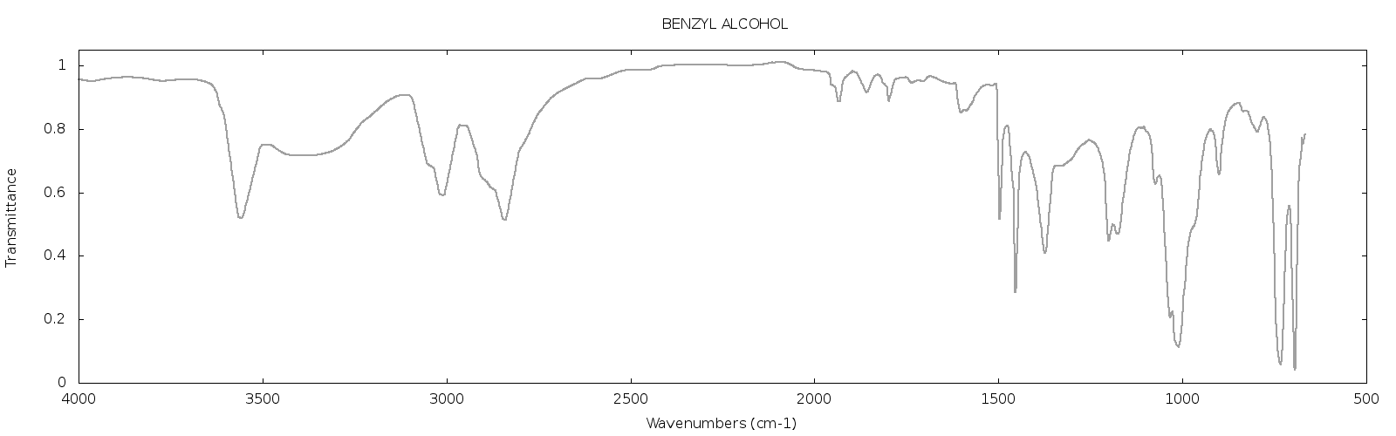
Department of Organic Chemistry
Source: bafa.vscht.cz
Notes:
Chemical equations, chemical formulas

Slide 7
Department of Organic Chemistry
Carefully log the source compounds, reactions, reaction conditions and tools used, synthetized products and the data coming from spectroscopic measurements, NMR, chromatography and other analytical methods
Huge amounts data coming from computational chemistry, where chemical properties reactions are simulated in silico
Results from high-throughput screening
Want to
Have the data safe, backed-up
Searchable data
Data available for all the team members, regardless of their geographical location, international collaboration

Slide 8
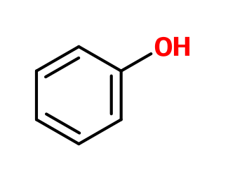
Department of Organic Chemistry
Make sure that the data are searchable
Find data about chemical compounds with substructure
Find all data containing a sharp peak in IR spectrum in the region of 2500-3000 cm⁻¹
And of course simple text searches

Slide 9
Department of Organic Chemistry
Keep the data private, reasons
Pending article about the reactions/compounds/data (publish or perish)
Patent claims
Data coming from the Laboratory of New Psychotropic Drugs and their results can’t be published in detail at all
Publish and open data later when the above issues are solved

Slide 10
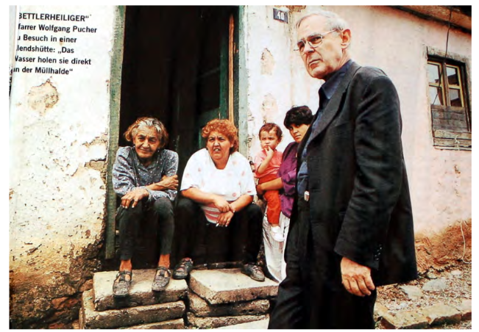
Romany Studies, Faculty of Arts, Charles University
Source: Multi-disciplinary approaches to Romany Studies,
CEU 2007-2009
Notes:
Lukáš

Slide 11
Romany Studies, Faculty of Arts, Charles University
Need to store recordings of interviews with Roma people from the Czech Republic and Slovakia together with different searchable metadata
Technical (where, when, data format, …)
Personal (who, personal relations, …)
Transcriptions, interview topics and summaries, tags, …
Problems:
Both data (recordings) and metadata contain personal information that should be visible only for the team members
Some parts of the recordings may contain descriptions of activities that could not be disclosed at the moment, should not be available even to the team but might be disclosed later

Slide 12
Romany Studies, Faculty of Arts, Charles University
From the data point of view, one resource (in this case a video recording) should have several manifestations:
Full version, archived but not available to anyone but the author
Version with some of the information stripped/blackened for the team members
Even more stripped version for public use
DTTO for metadata
Highest protection: SSN and other person identifiers
Medium protection: date of birth
No protection: age
The sets of data and metadata with a given level of protection changes in time
Notes:
DTTO – detto/same
SSN – social security number

Slide 13
Comparison
 | Chemists | Romany Studies | Classical libraries
Data formats | Mainly specialized data formats: Molecules, reactions, spectra, other measurements | Mainly annotated multimedia: Videos, metadata about people, personal relations | Classical DCTerms as you know them: Title, Author, Abstract, …
Search | Substructure search, search by features in graphs, in metadata ann. | Searching in metadata annotations, transcriptions, … | Searching in metadata annotations
Data amounts | Huge (in case of computational chemistry) | Large | If not storing digitized data, moderate
Security | Very well defined and enforced | Very well defined and enforced, to the level of single metadatum | “Everything should be public, open access is the goal”
Data entry | “Do not bother me with that” | “I know I have to add transcriptions” | Metadata specialists entering info

Slide 14
Our Quest
Data repository containing diverse data and associated metadata and providing customizable UI for searching, viewing and basic editing the data
Easy to use tools for data filling
For chemistry, automatically send laboratory data to the server, run algorithms on measured data to identify and index search features
For Romany studies, have a mobile application for audio/video capture together with tagging and transcription tools, sending the data directly to the repository
Notes:
Míra

Slide 15
Architecture
UI layer based on Django
Data access layer
Repository backend
Search backend
Automatic
tasks
Metadata view
Metadata view
Model definition
Model definition
}
}
HTML
Python

Slide 16
Cross-field repository
Repository backends
DSpace
Invenio
Fedora
Search engines
SOLR
Elastic Search
Programming language
Python/Java
Photo: maps.google.com
Notes:
Lukáš
Similar performance
Invenio: MARC only
Fedora: clean modulary design
versioning
- used as storage for data, templates, authentization Elastic Search: nested documents
parent-child relationship (You can search parents document which children meet the specified conditions. And oposit way – search children which parents meets specified conditions)

Slide 17
Cross-field repository
Current status
Implemented proof of concept – institutional repository of UCT Prague which is now in production
Implemented proof of concept – repository for Romany studies
Initial steps in OCH data
Enough of talking, where are the screenshots?
Photo: maps.google.com
Notes:
OCH – organic chemistry

Slide 18
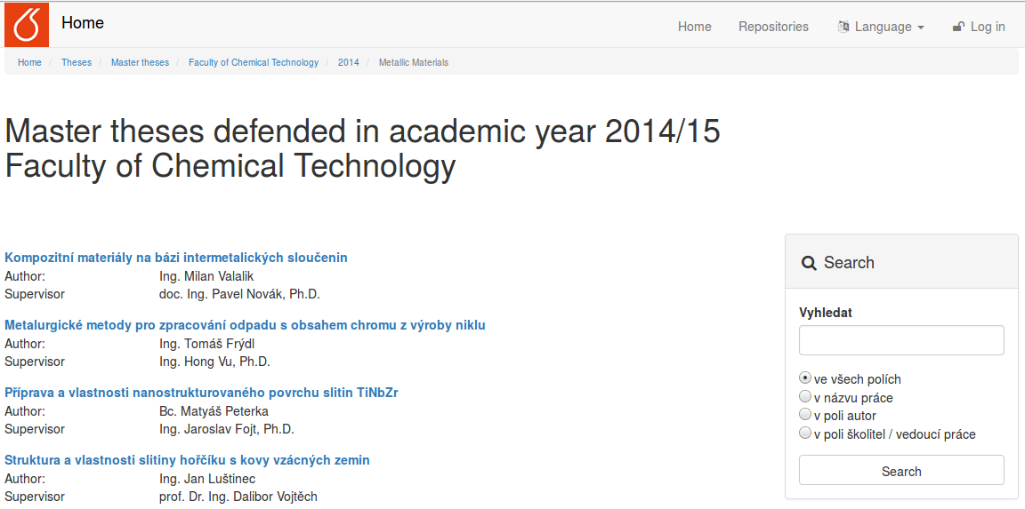
Look and Feel – classical repository
Notes:
Míra

Slide 19
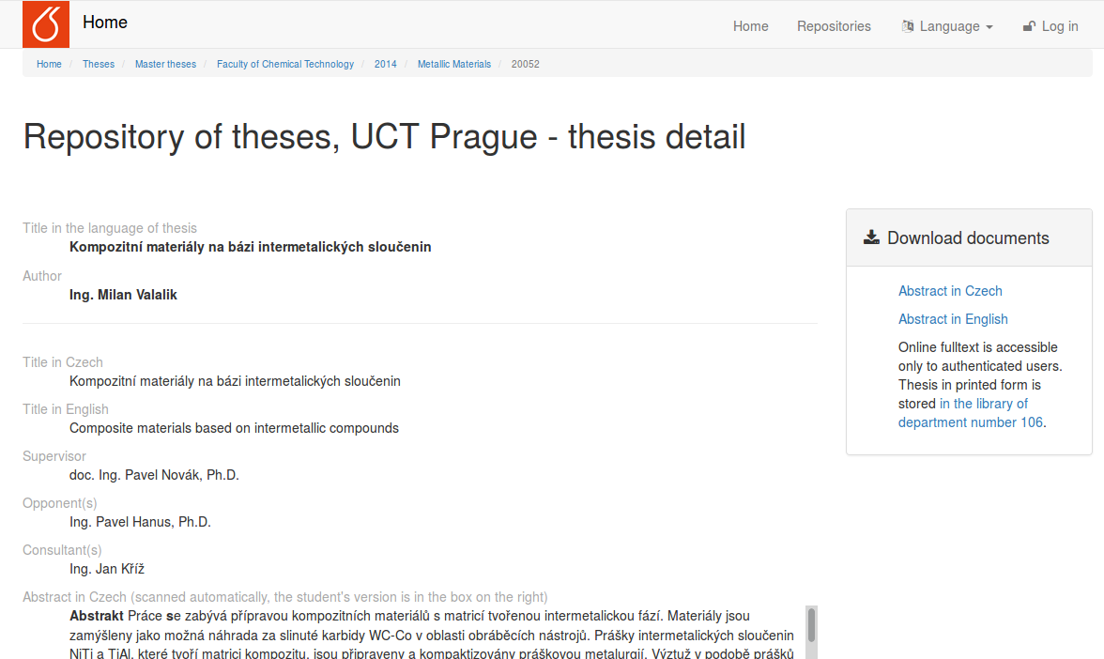
Look and Feel – classical repository

Slide 20
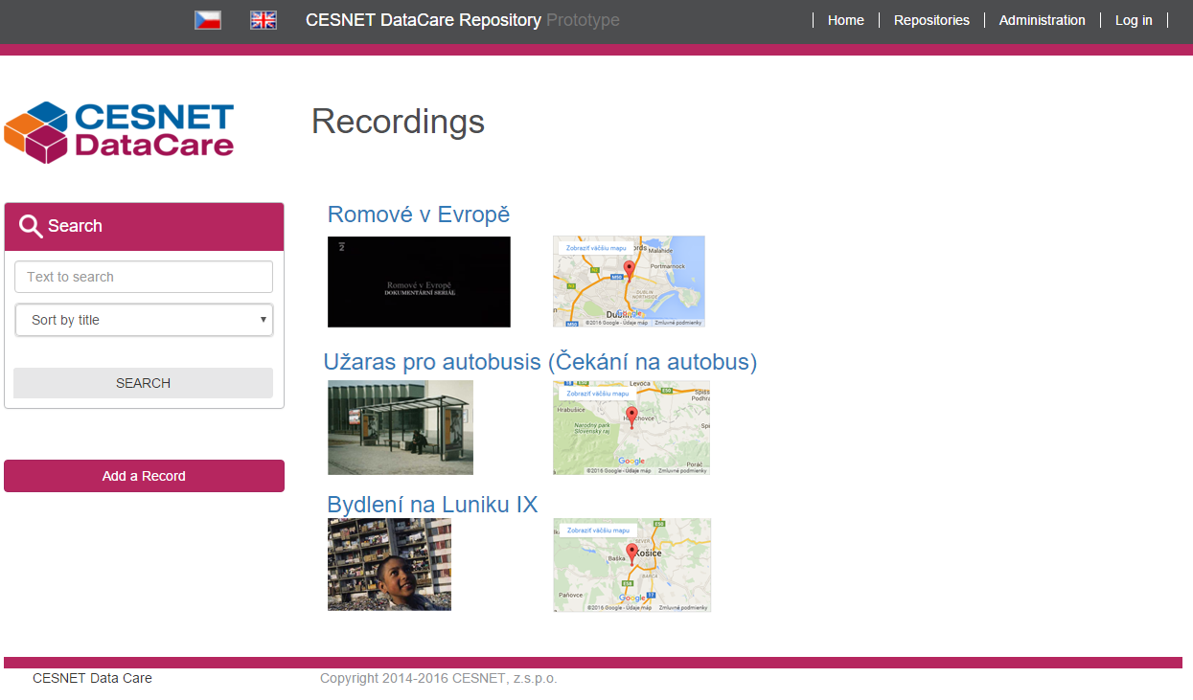
Look and Feel – Romany studies
Notes:
Lukáš

Slide 21
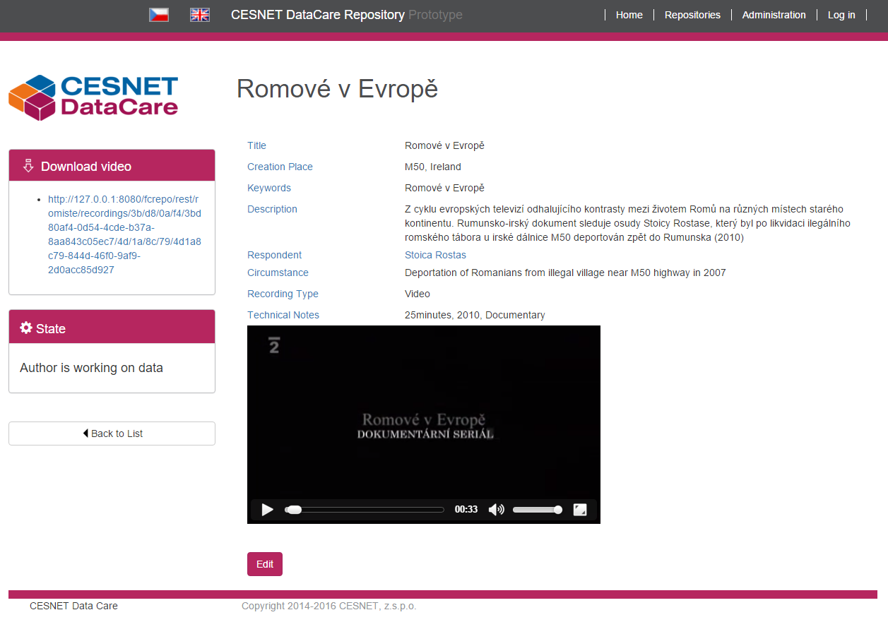
Look and Feel – Romany studies
Notes:
Next slide video

Slide 22

Look and Feel – Romany studies

Slide 23
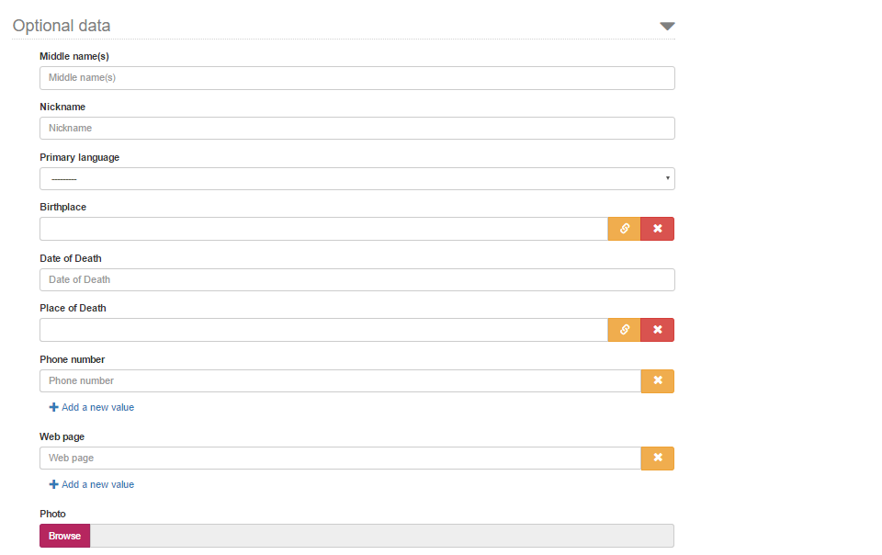
Look and Feel – Romany studies

Slide 24
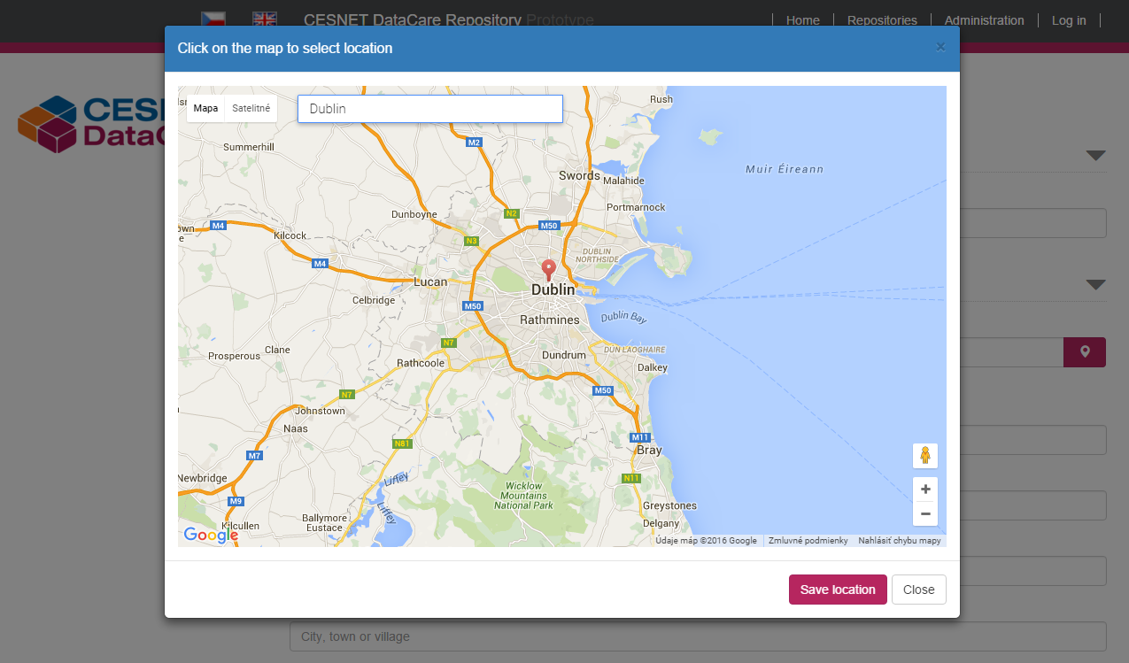
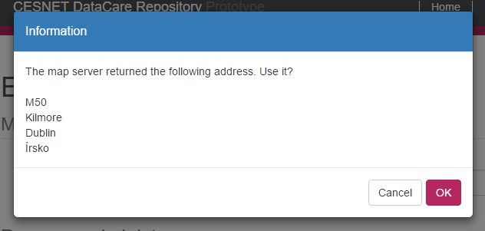
Look and Feel – Romany studies

Slide 25
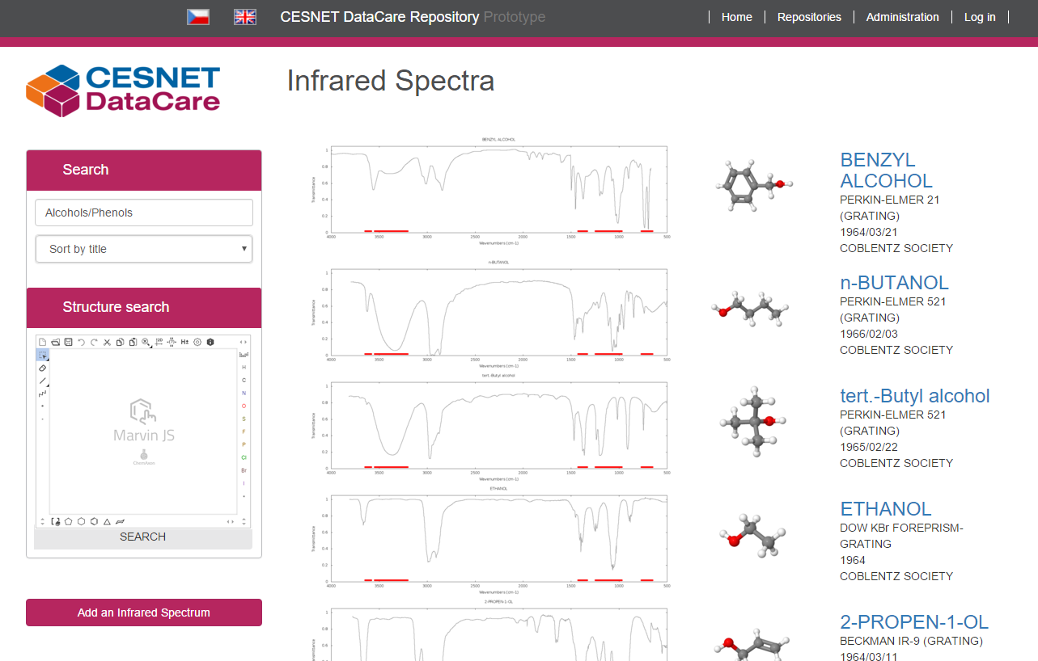
Look and Feel – Spectroscopic data

Slide 26
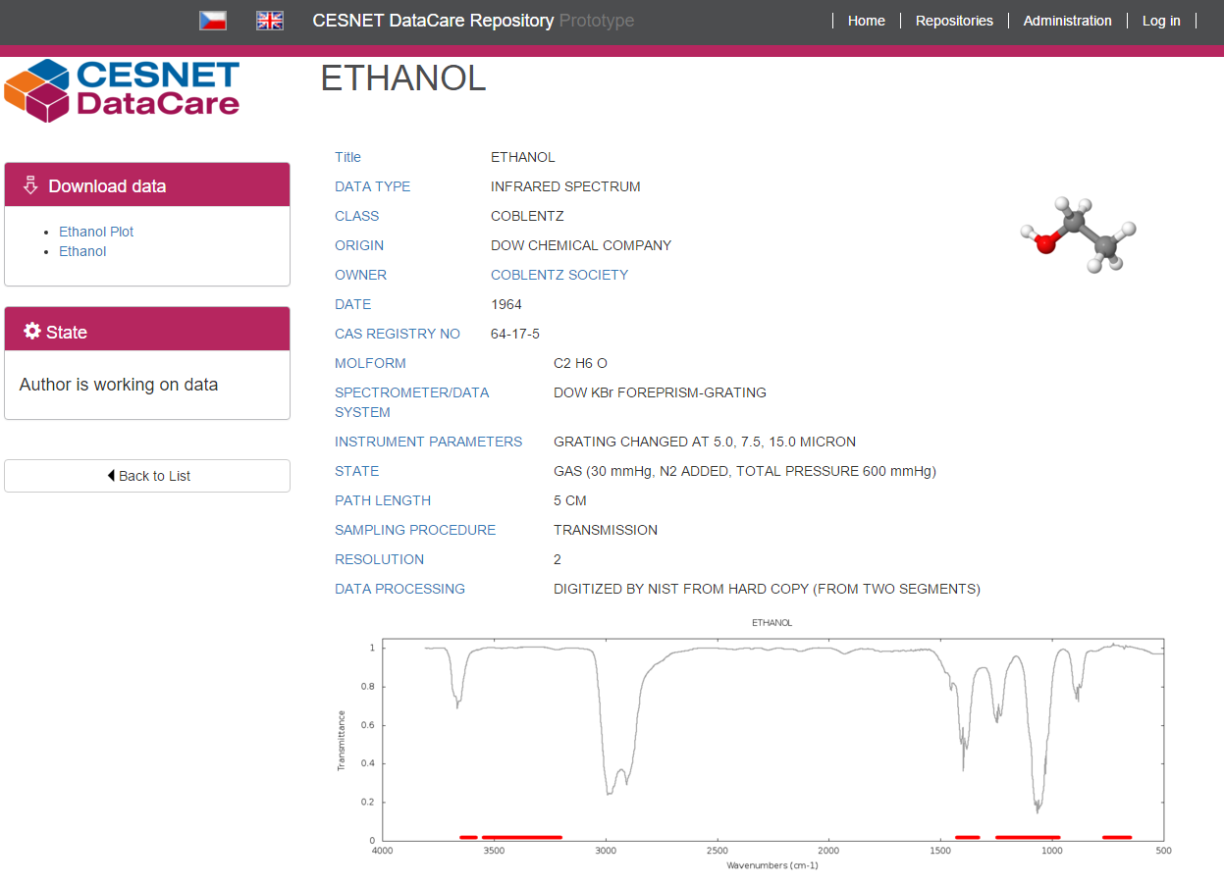
Look and Feel – Spectroscopic data

Slide 27
Cross-field repository
This year
Finalize repository for Romany studies
Finalize proof of concept for OCH data
Start working on media repository at UCT Prague and its connection to e-learning and online teaching materials
Polishing codebase and making it opensource
Working on standards adoption, cooperation with other Fedora users
Following years
Other scientific fields, perhaps turning it into a national repository of scientific data
Photo: maps.google.com
Notes:
Mira

Slide 28
Thanks
Ing. Jan Horníček
Mgr. Jan Pokorný
Bc. Michal Strnad
RNDr. David Antoš, Ph.D.
PhDr. Jan Červenka, Ph.D.

Slide 29





Special thanks
bleach | inflection | isodate | pyparsing
django-bootstrap-pagination | rdflib | requests | python-dateutil
bootstrap | jquery | bootstrap3-dialogs | Google APIs

Slide 30
Architecture end of the year
CESNET DataCare Repository
Custom templates
Built-in templates
Typed API
Untyped API
State engine
Field
AC
Fedora
Metadata
Data
WebAC
States
Custom data
definition
Custom templates
Data add-ons
Custom data definition
Data add-ons
Built-in datatypes
Schema mgmt
Elastic Search
House keeping tasks and data conversion

Slide 31
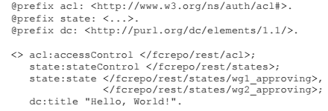
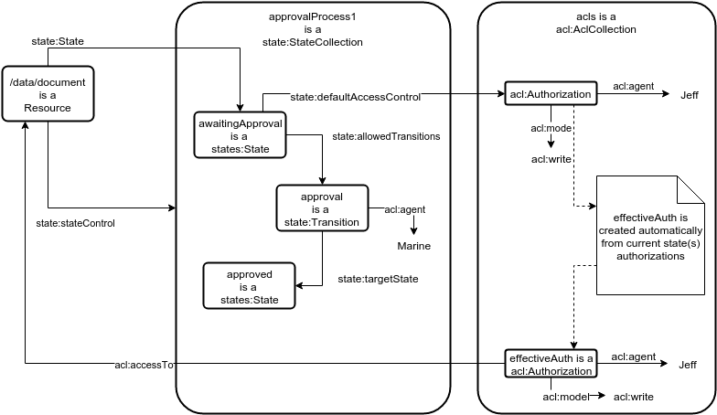
Architecture - states

